Slide 1
REAL LIFE LAB(RLL) Project
INSURANCE POLICY MANAGEMENT
(GROUP NO: 8)

Slide 2
TEAM MEMBERS
Suraj Kumar Samantha - 2579264
Thummala RaviKumar - 2580111
Tappetla tanuj kumar - 2580298
Tummuri Pavani - 2580129
Ullas H P – 2579982
Yogendra Kumar - 2579607
Vedika Virsen Patil - 2579727
Vajjala Kalyan - 2579697

Slide 3
INDEX
Objective
Introduction
Project Scope
Existing System
Proposed System
Project Requirements
Tools and Technologies
Technology Stack
Flowchart
Modules
Demonstration
Conclusion
Future Scope

Slide 4
OBJECTIVE
Create a dynamic and responsive web application for managing the insurance policies application online.
We have created a bug-free application for the admin and the user with the main objective to build a secured, robust Insurance Management System where the policies are managed systematically.
This web application maintains the record of customer history and policies efficiently so that it would be easily accessible.

Slide 5
INTRODUCTION
Insurance will help the families in maintaining their standard of living in case if we are not around in the future.
Insurance is all about providing financial safety to the individual or Vehicles.
It helps us to enjoy financial security.
If we have a proper application to access all the Insurance related activity, then it will be cheery on top.

Slide 6
Project Scope
User and Admin Management
Policy Category Management
Policy Management
Customer Interaction
Database Schema Design

Slide 7
Existing System
In the existing system, customers required to physically visit insurance offices or rely on postal services for communication.
This can be inconvenient for individuals who prefer or need immediate access to policy information and services.
The flow of an offline insurance policy system typically involves a series of manual and paper-based processes. Paper-based processes in offline systems are typically slower than digital ones.
High cost, relying on agents or customer service representatives for policy updates, changes and inquiries, security concerns etc...

Slide 8
Proposed System
The proposed system is to automate that the policies can be applied through online efficiently, conveniently and flexibly.
This system majorly contains two roles:
1. Admin
2. Customer
Admin can add, view, update, delete, approve the policy applies by the customer, he’ll also be able to answer the queries asked by the customers.
A customer can add and update his account, can view the policies that are added by the admin and the customer can apply for the policy if she/he likes it, the customer can also be able to ask queries to the admin.
Finally, the proposed system is accessible 24/7 from anywhere with an internet connection, allowing policyholders to review policy information, make payments, and initiate changes at their convenience, without the need to visit a physical office.

Slide 9
Tools & technologies
Front-End: Angular
Server-side: Spring Boot
Back-End: MYSQL, Hibernate
Server: Tomcat

Slide 10
Technology Stack
ANGULAR
Angular is an open-source, JavaScript framework written in TypeScript. Google maintains it, and its primary purpose is to develop single-page applications.
SPRINGBOOT
Spring Boot is a Java framework, built on top of the Spring, used for developing web applications. It allows you to create REST APIs with minimal configurations.

Slide 11
Technology Stack
MYSQL
MySQL is a tool used to manage databases and servers, so while it's not a database, it's widely used in relation to managing and organising data in databases.
SPRING JPA
Spring Data JPA aims to significantly improve the implementation of data access layers by reducing the effort to the amount that's actually needed. It provides custom finder methods, and Spring will provide the implementation automatically.

Slide 12
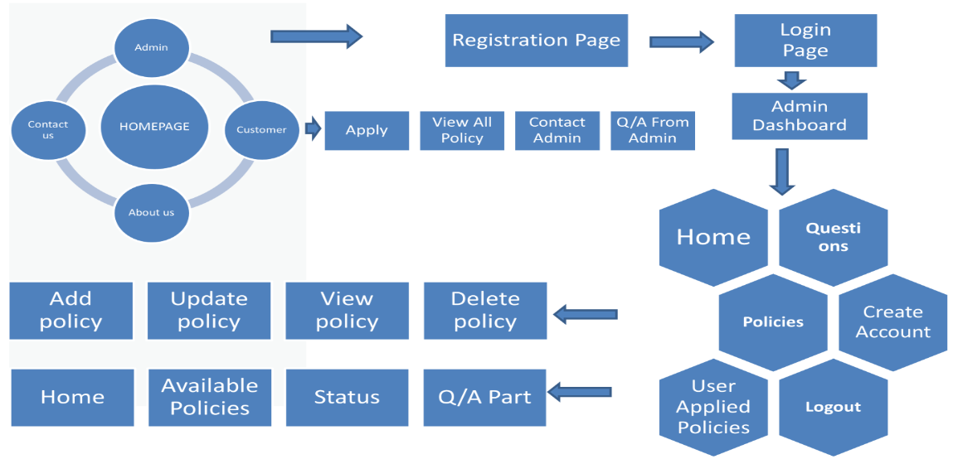
Flowchart

Slide 13
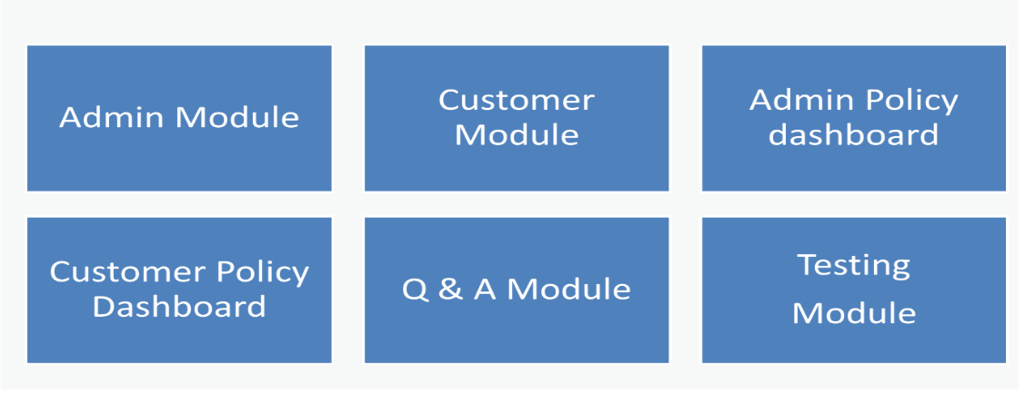
MODULES

Slide 14
BRIEF ABOUT MODULES
Admin validation: In this module, we validate admin and user details, according to their credentials and create the accounts for customers.
Admin policy dashboard: On admin dashboard, policies are managed by admin. And the other features are available.
User/Customer policy dashboard: On customer dashboard, User can access policy and apply and raise queries to admin.

Slide 15
BRIEF ABOUT MODULES
Q/A Module: In this Q&A part, Incase any doubts we can contact to admin, regarding queries and raising queries.
Testing: In this part, we had done testing, to fix bugs and automate the webpages.

Slide 16

DEMONSTRATION

Slide 17
ADMIN MODULE
Login to the portal
Create Admin Account
View/Delete customer.
View/Add/Update/Delete policy category like Life, Health, Motor, Travel
View/Add/Update/Delete /Approve policy.
View total policy holder, approved policy holder, disapproved policy holder.
Approve policy, applied by customer.8.Answer customer question

Slide 18
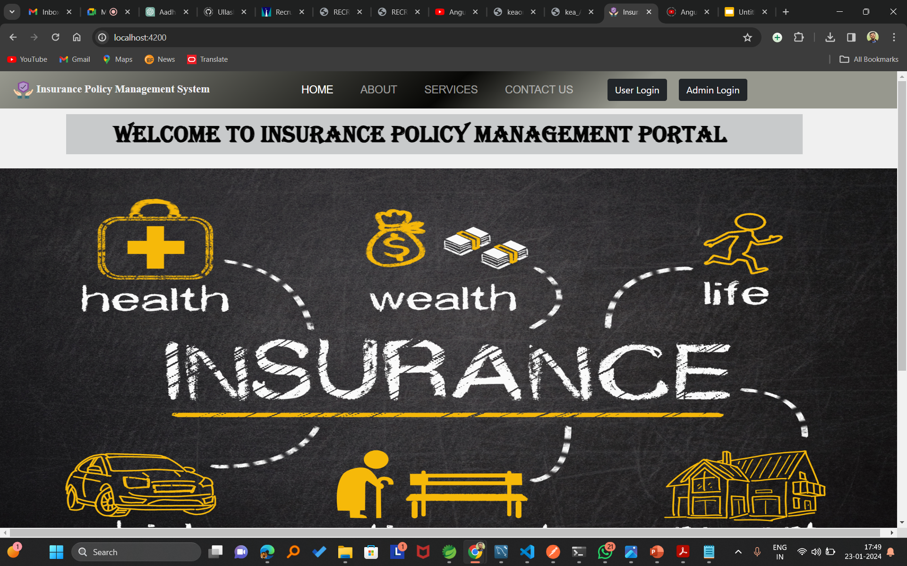
ADMIN HOMEPAGE

Slide 19
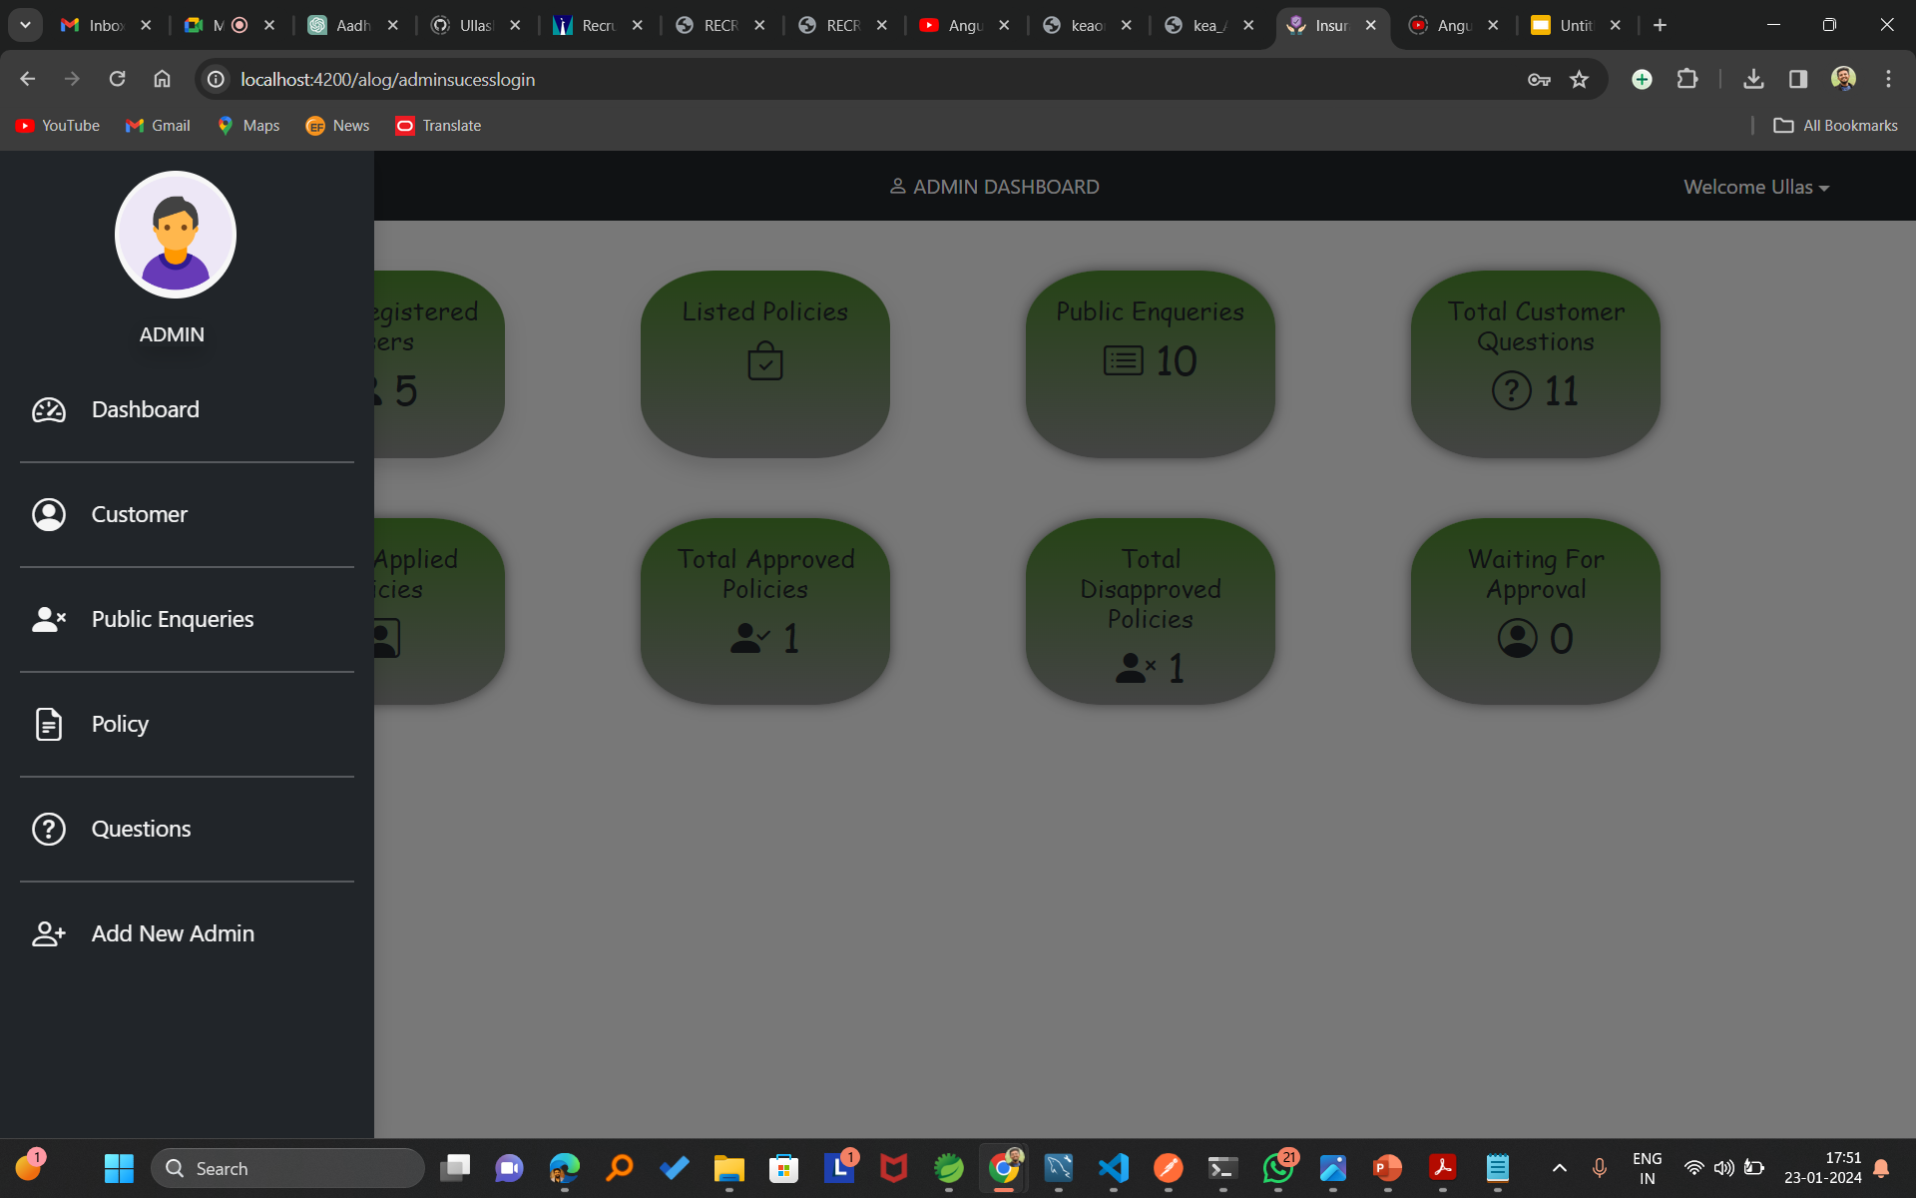
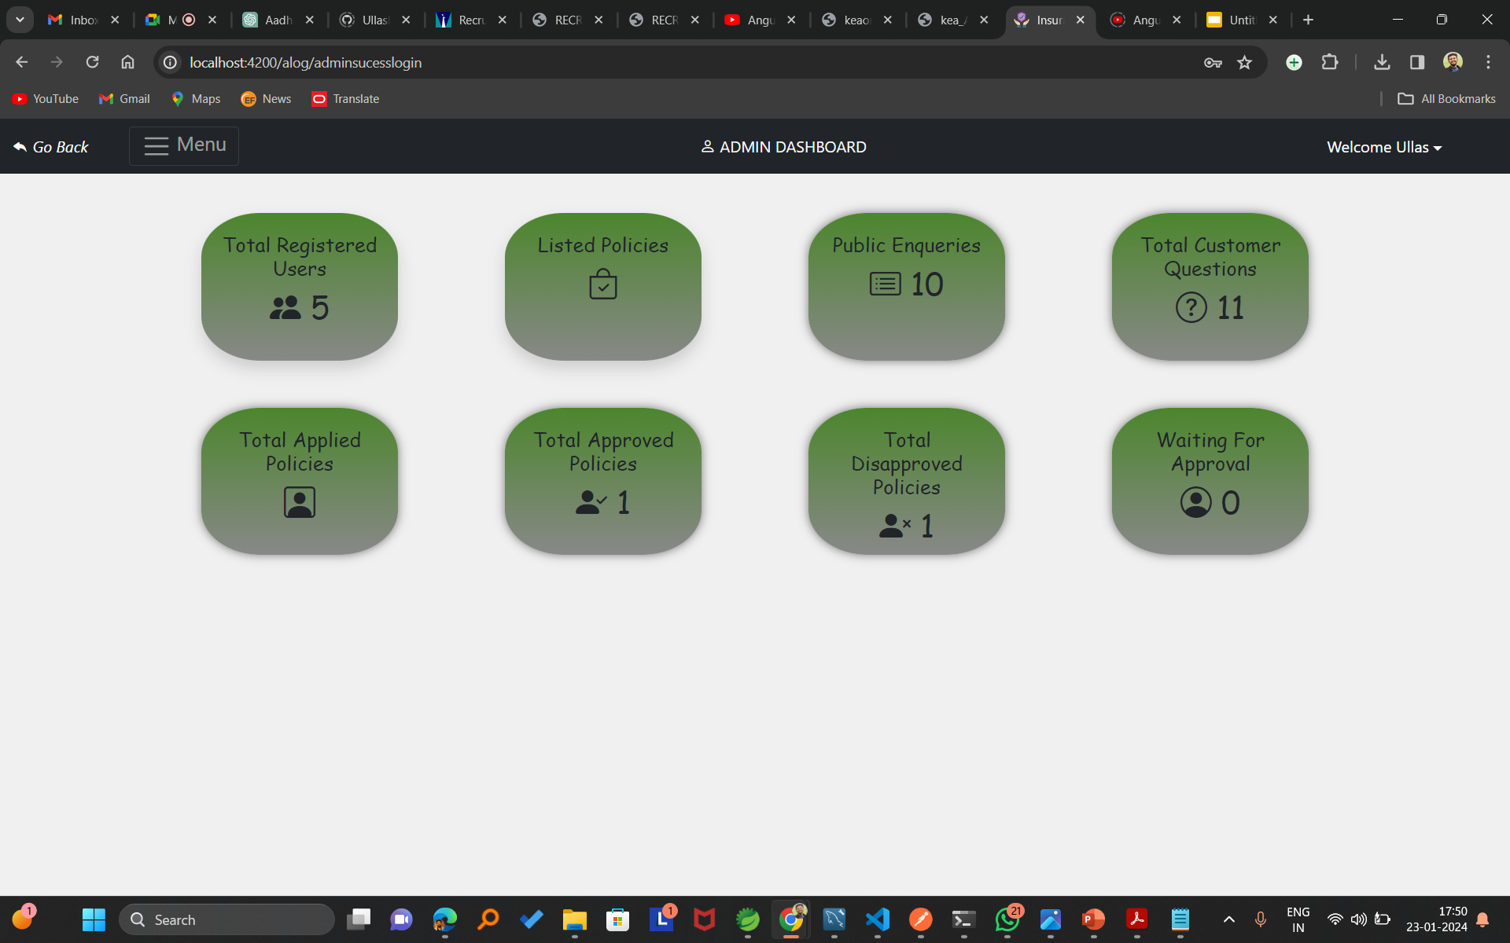
ADMIN DASHBOARD

Slide 20
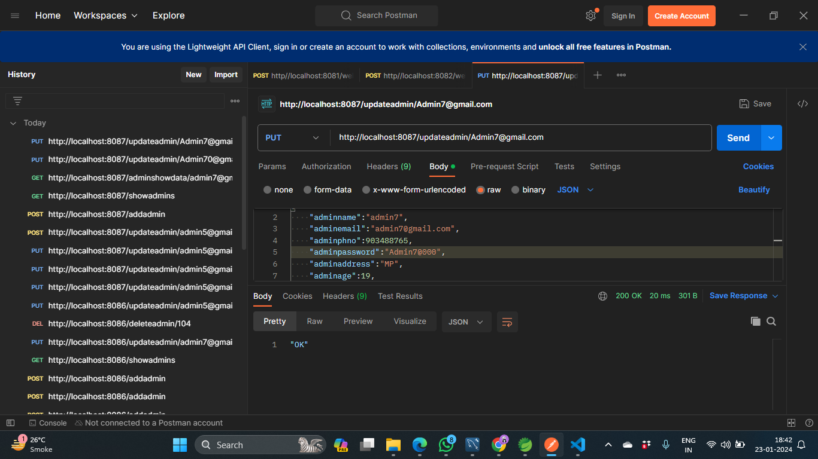
Postman Testing

Slide 21
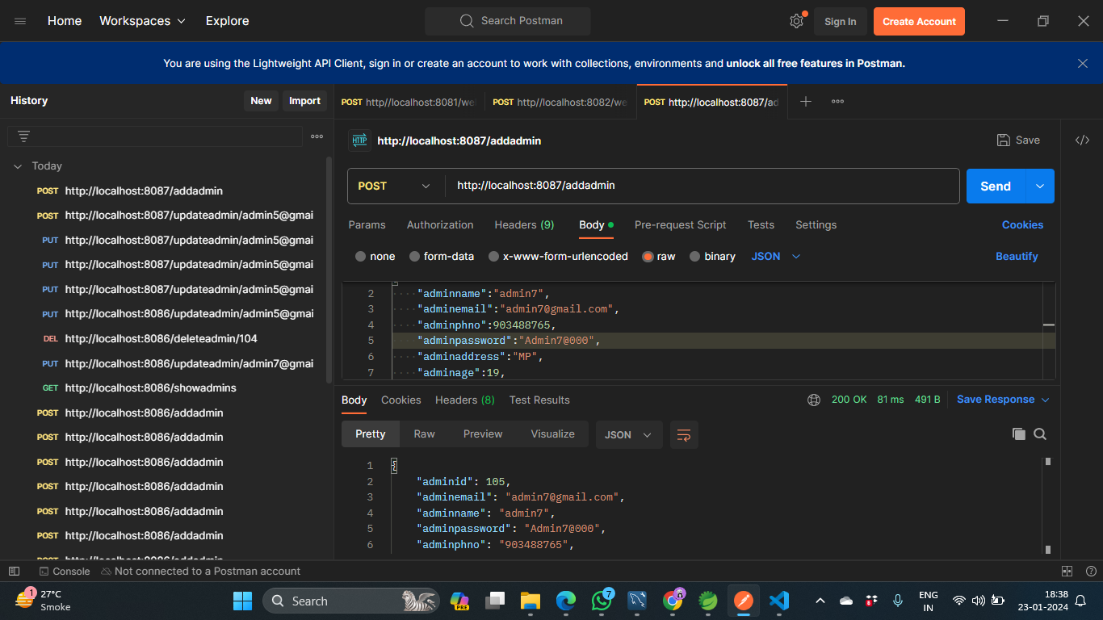
Postman Testing

Slide 22
USER MODULE
Create account (no approval required by admin)
Change the password.
Change address, email, mobile.
View all policy that are added by admin.
If customer likes any policy, then they can apply for it.
When customer applies for any policy, it will go into pending status, admin can approve it.
Customer can check status of his policy under history section.
Customer can ask question from admin.

Slide 23
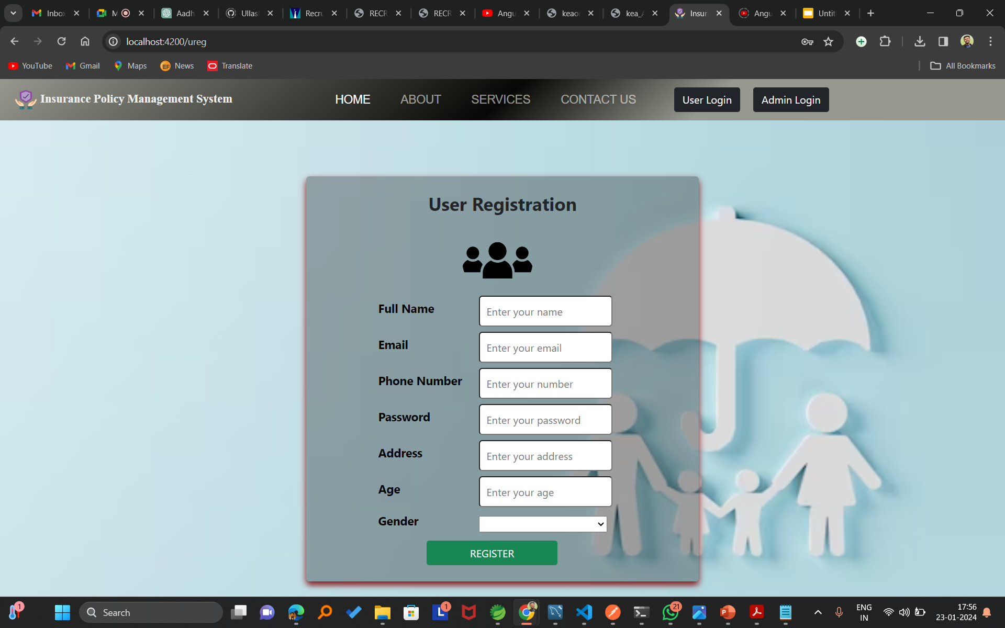
USER REGISTRATION

Slide 24
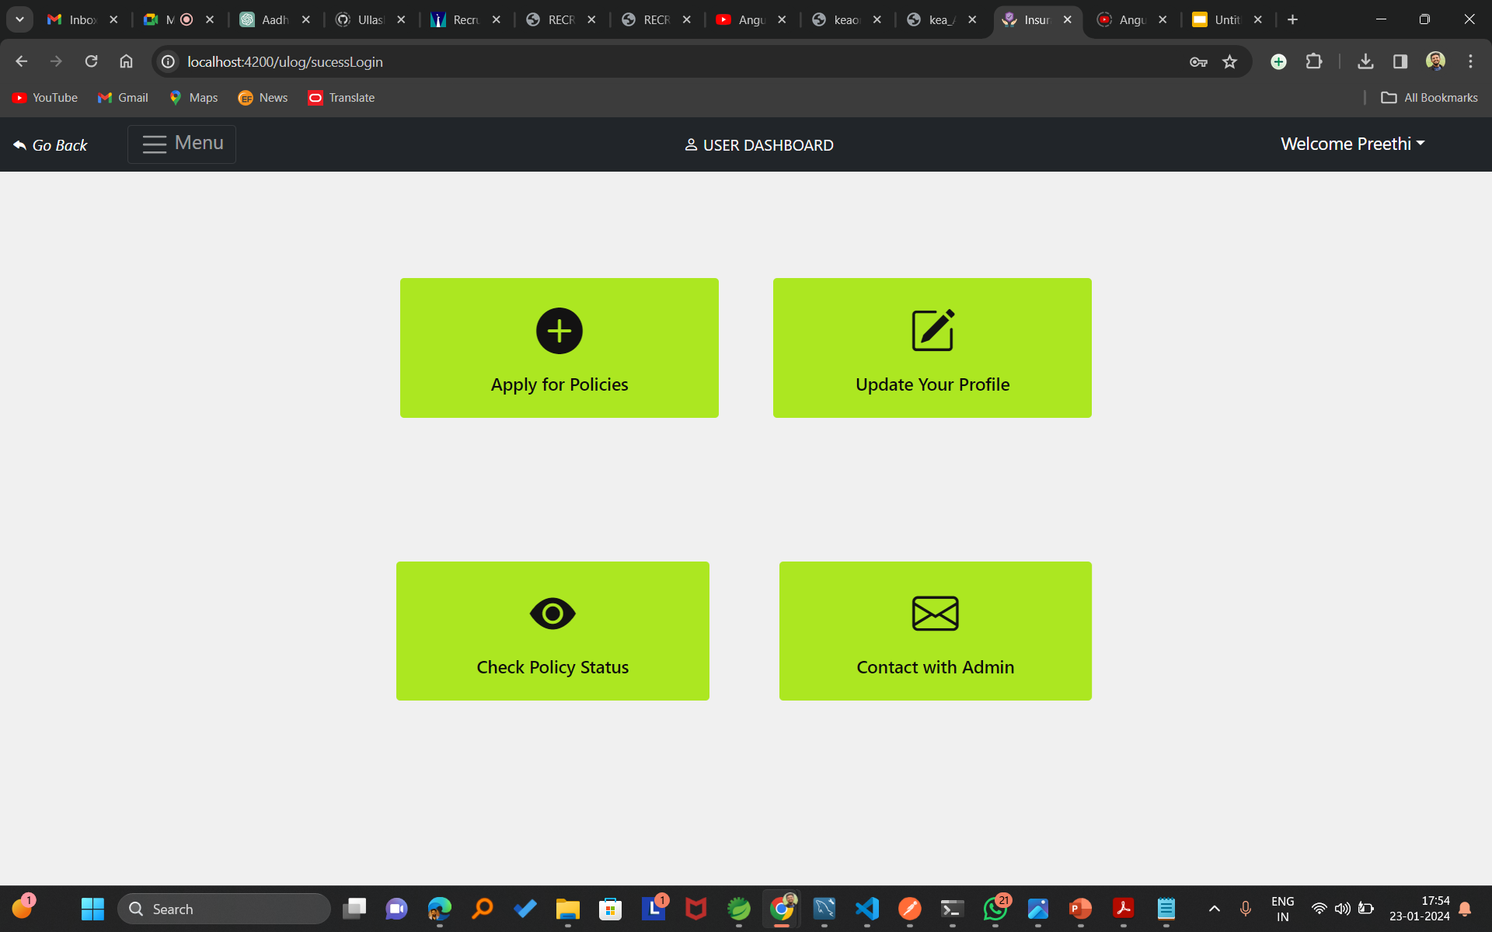
USER HOMEPAGE

Slide 25
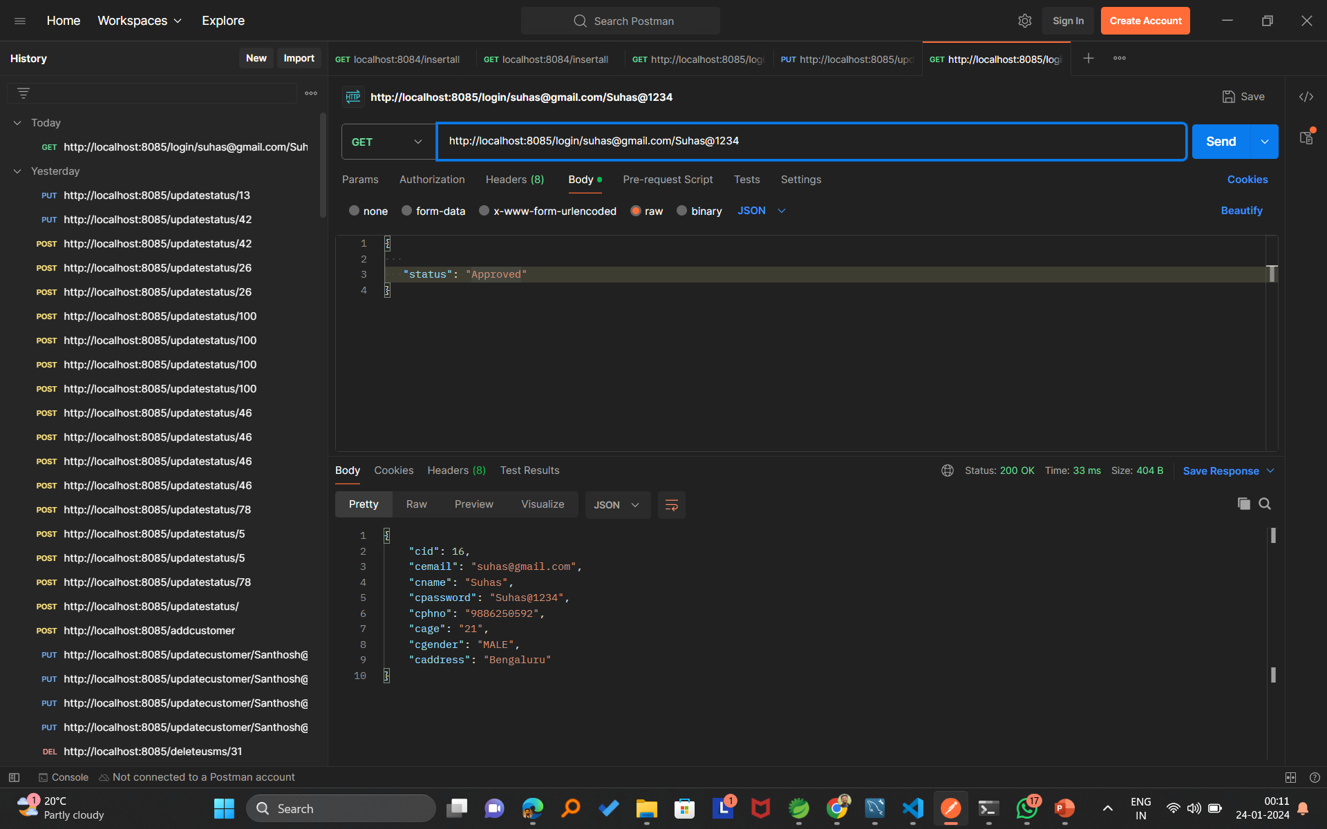
Postman Testing

Slide 26
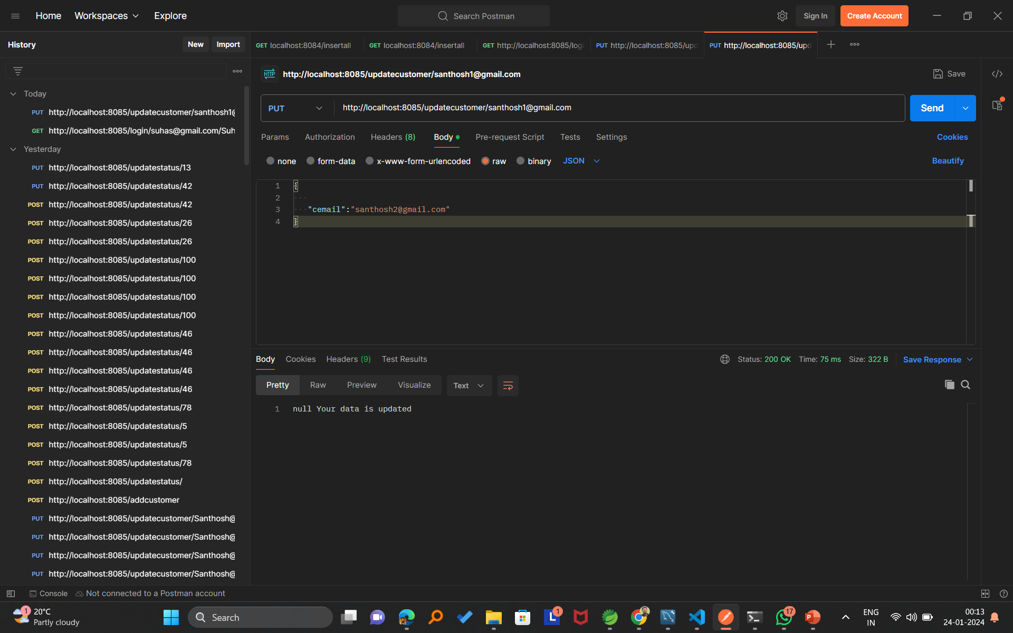
Postman Testing

Slide 27
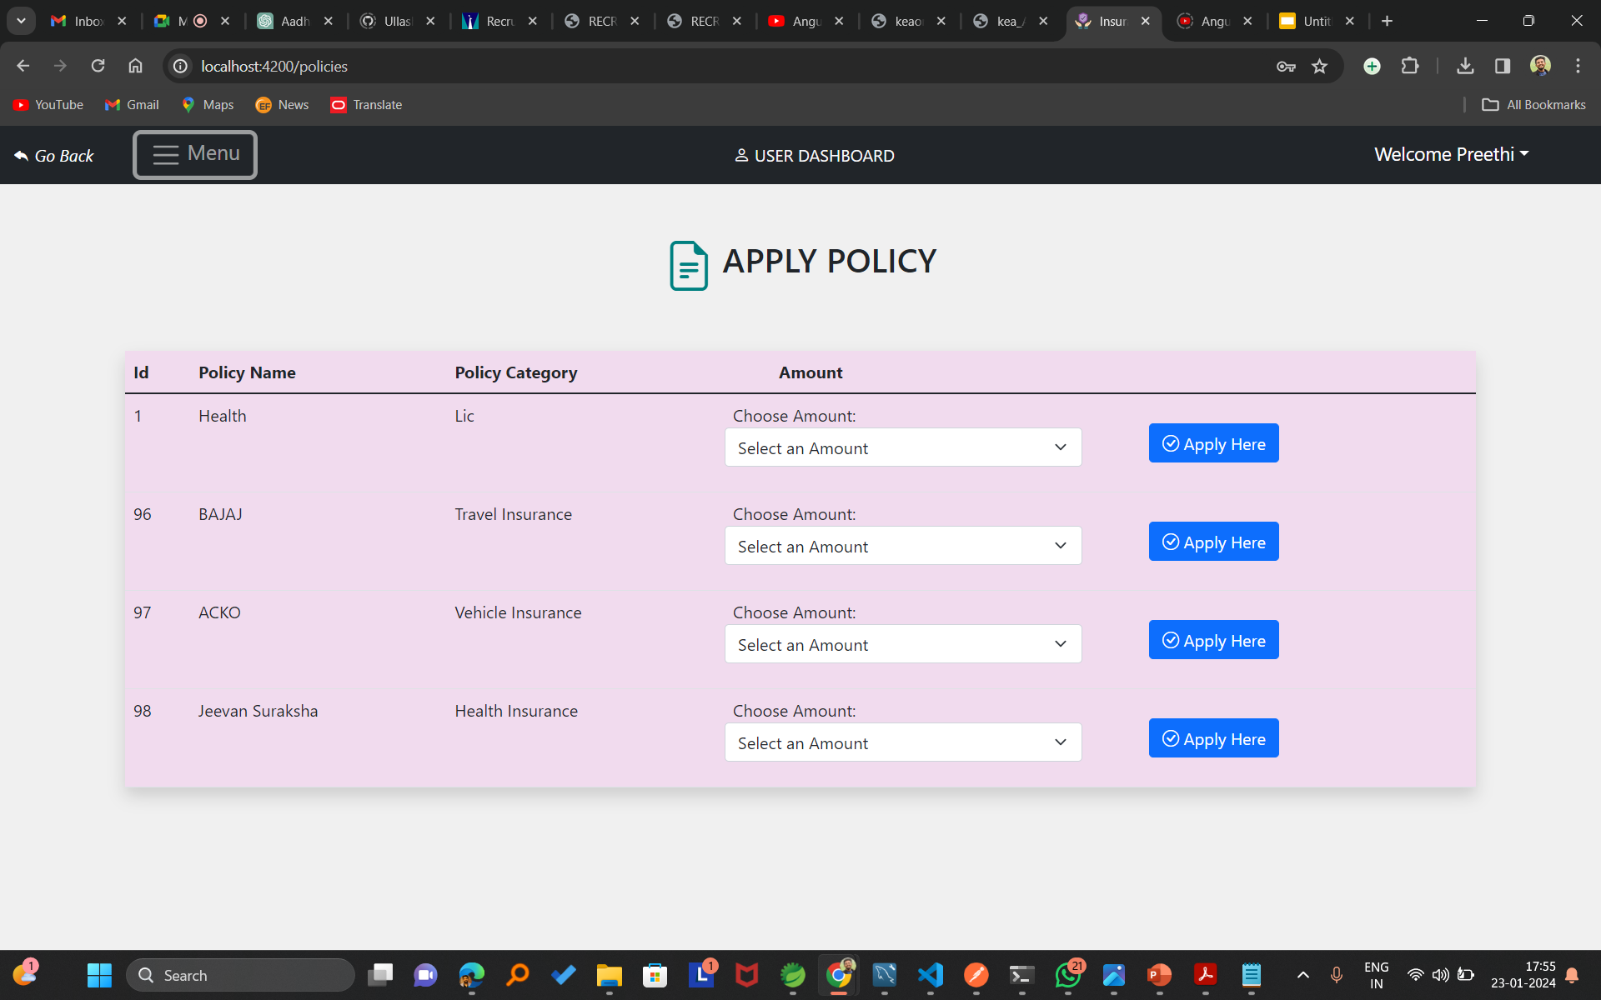
POLICY DASHBOARD

Slide 28
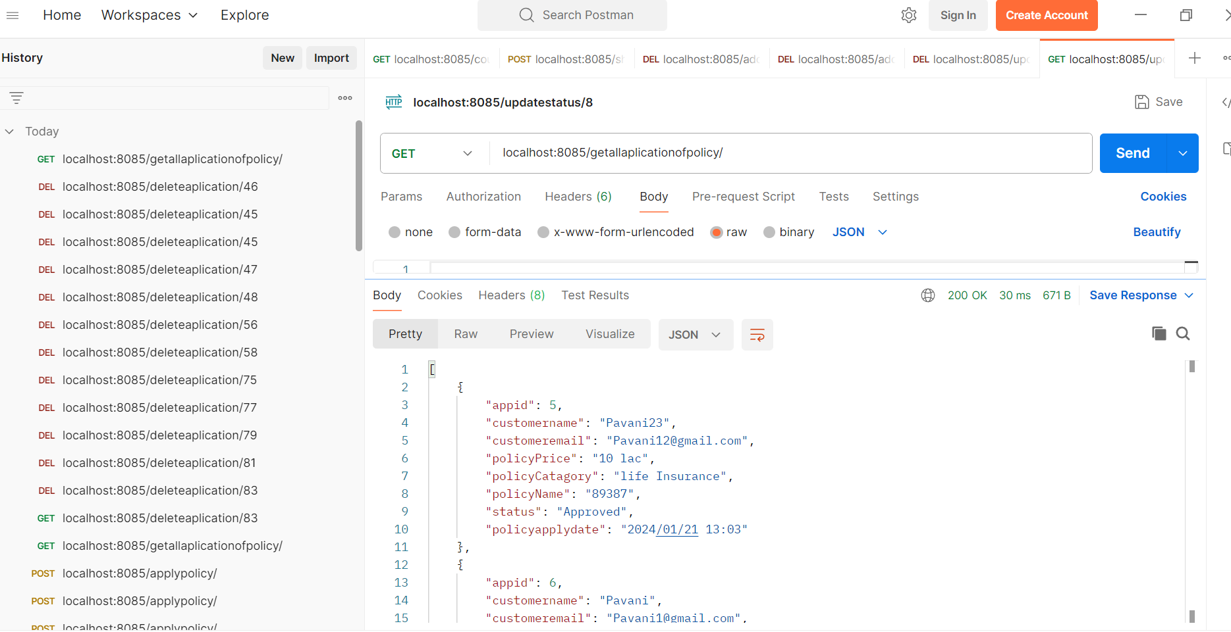
Postman Testing

Slide 29
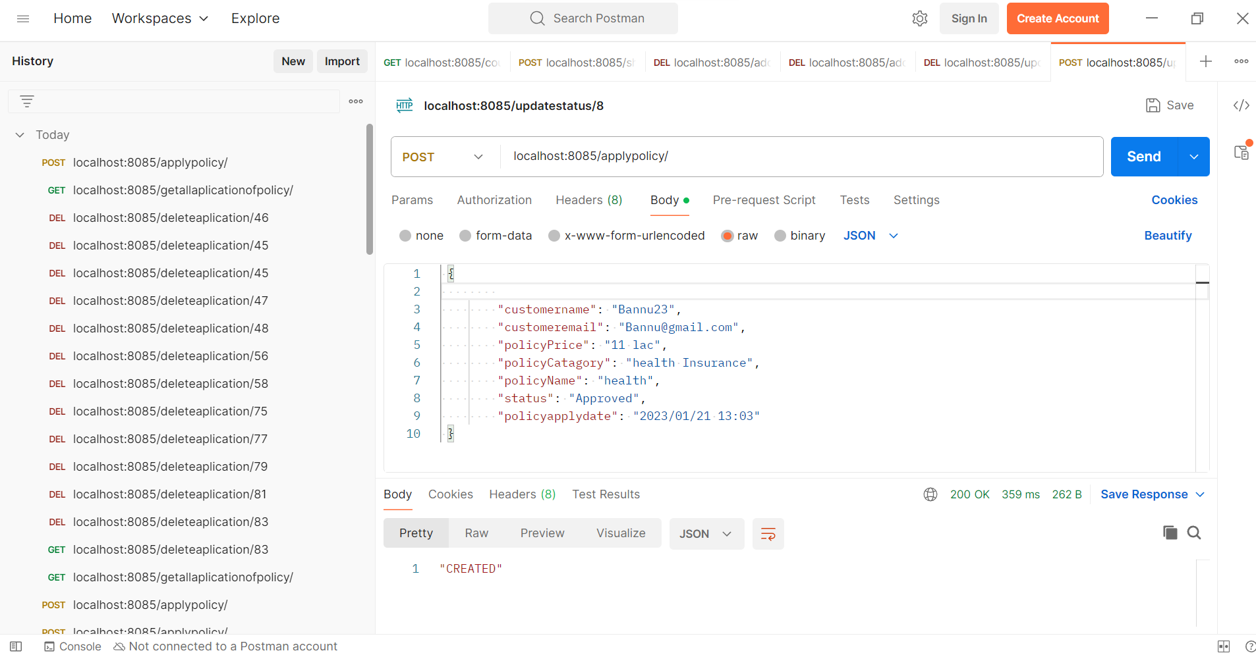
Postman Testing

Slide 30
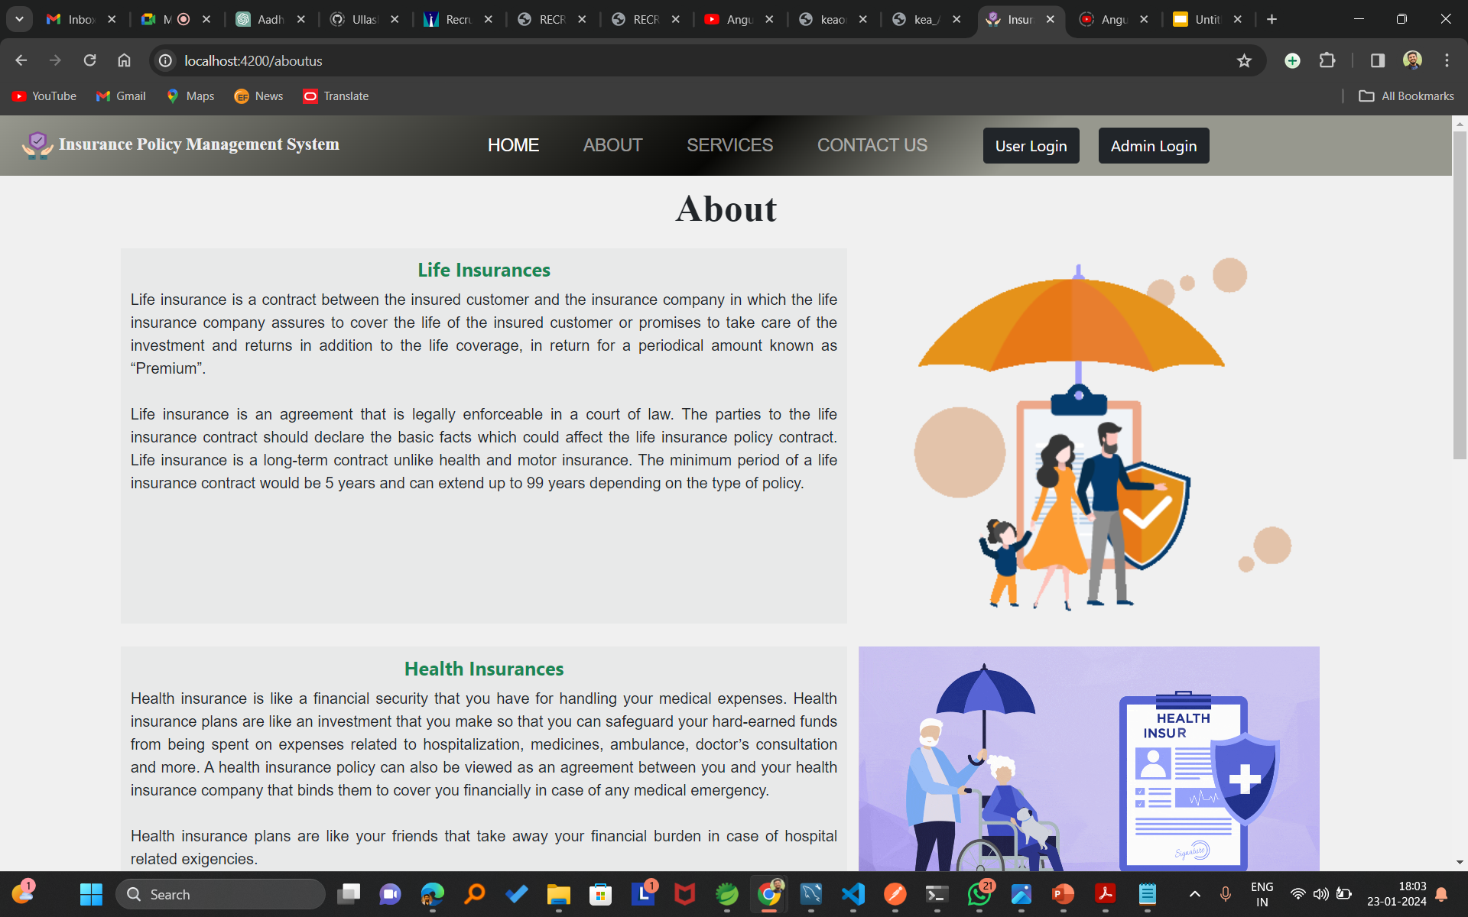
ABOUT US

Slide 31
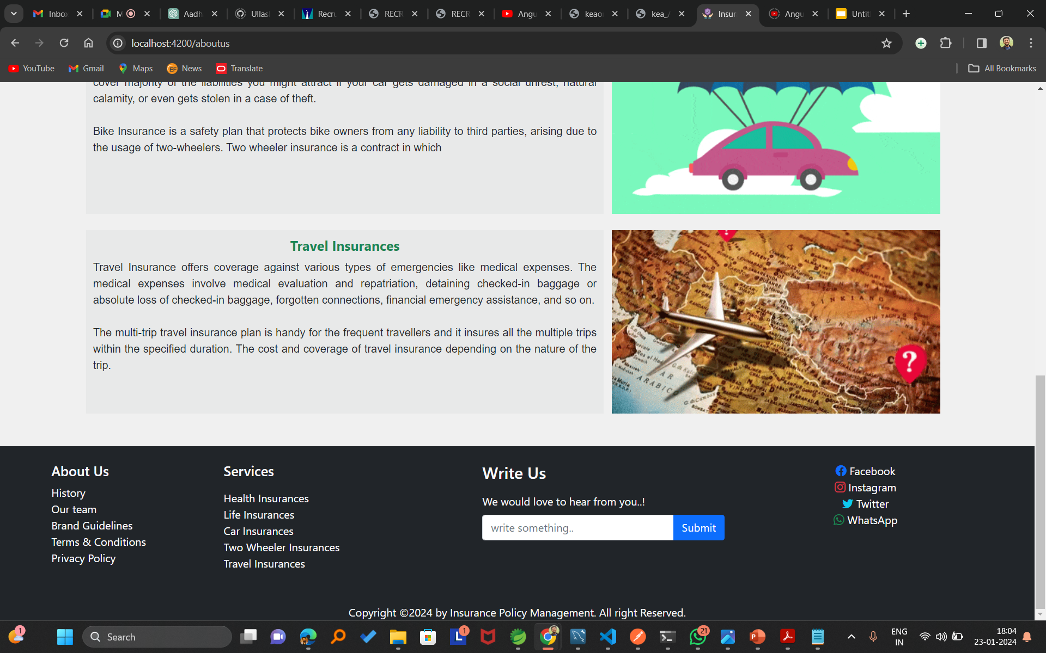
ABOUT US

Slide 32
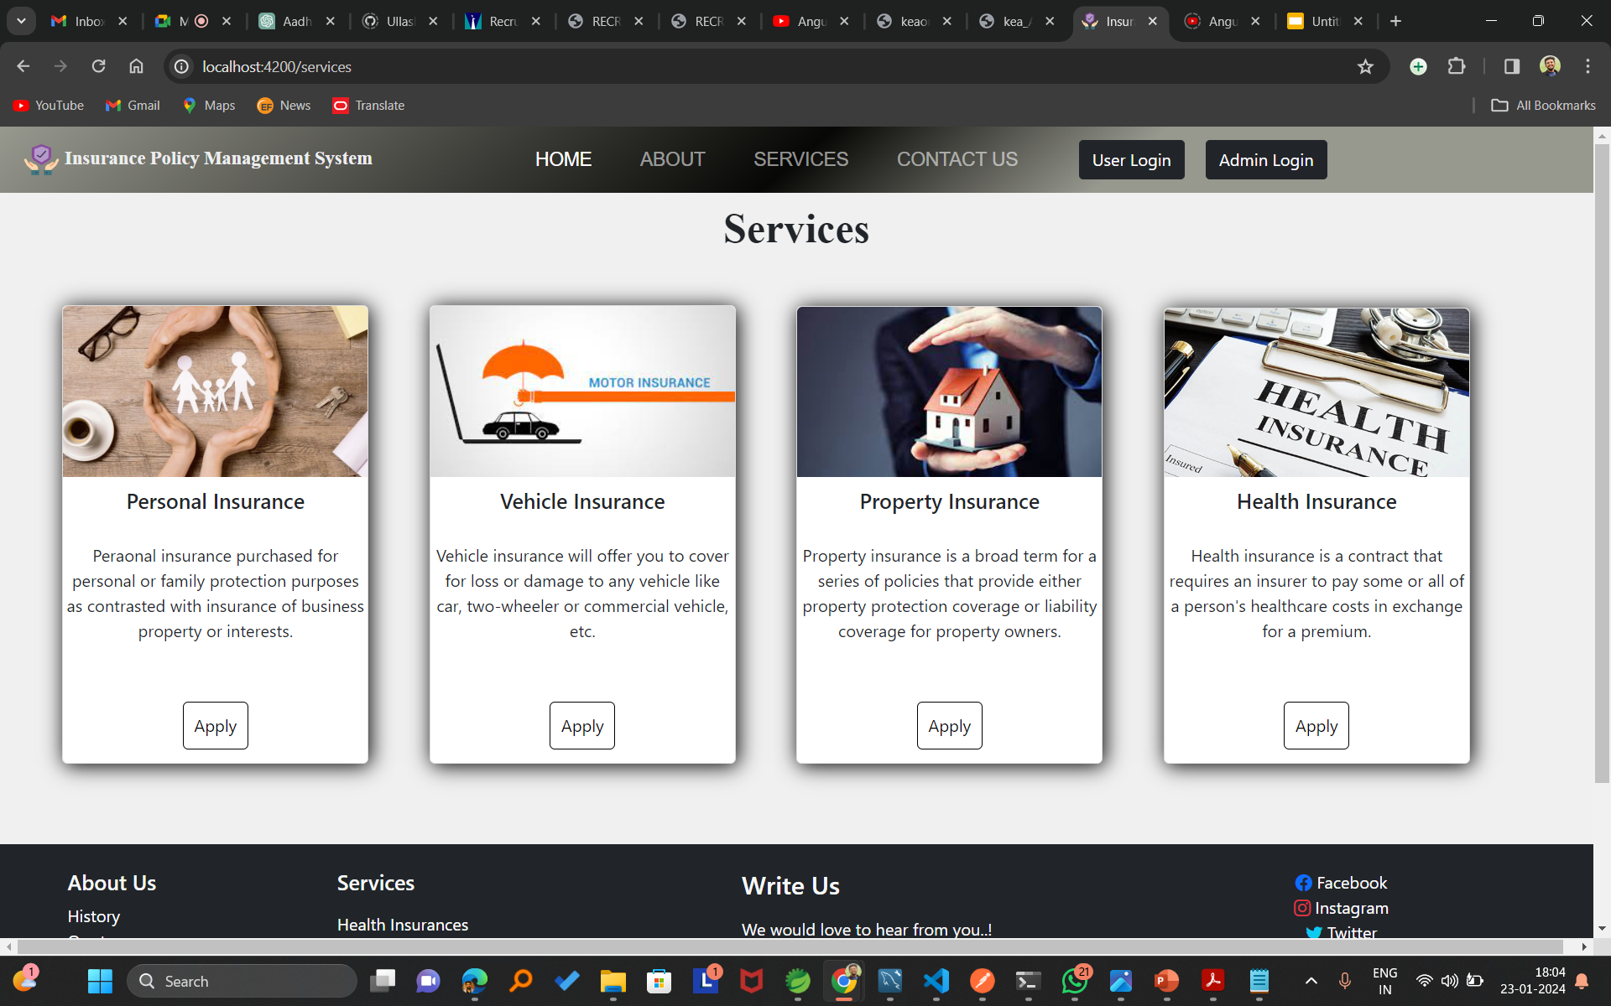
SERVICES

Slide 33
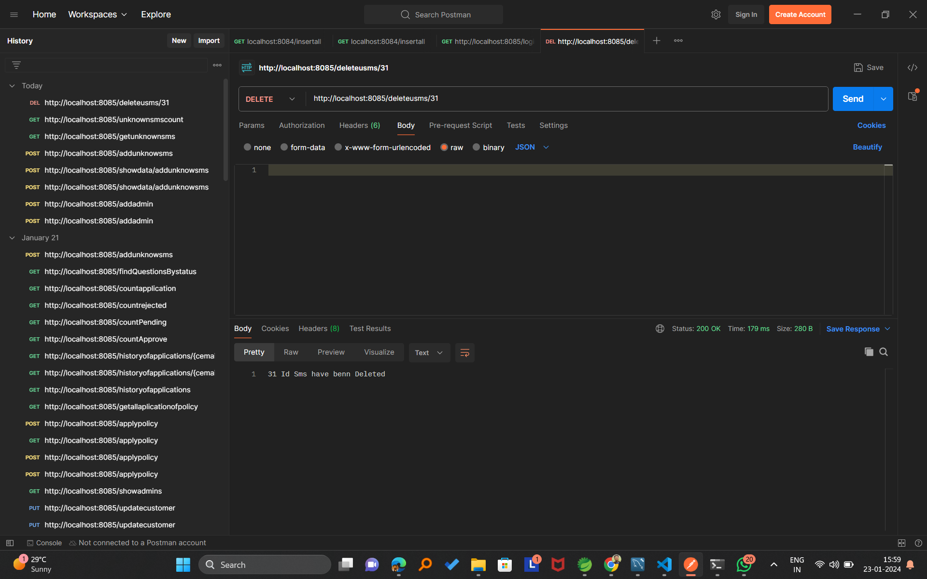
Postman Testing

Slide 34
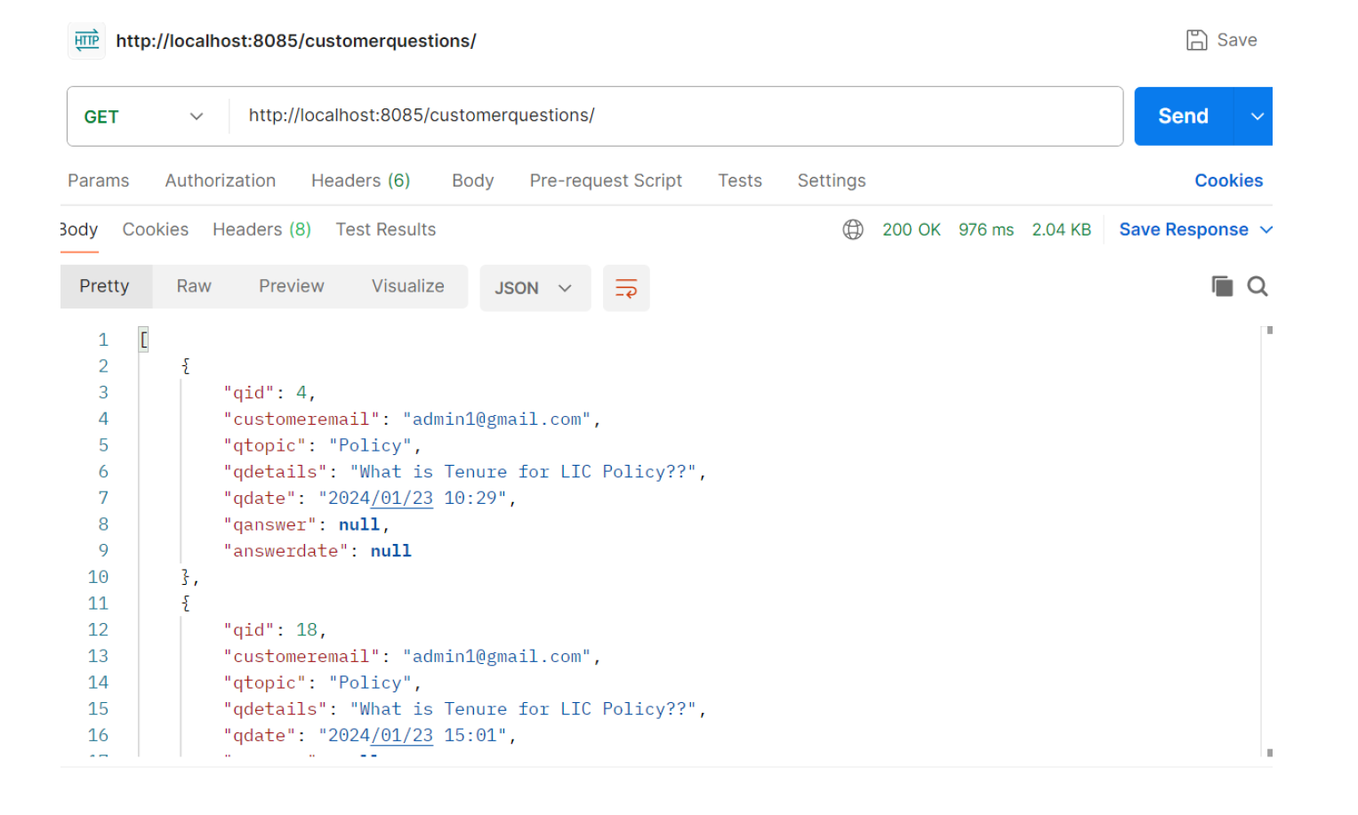
Postman Testing

Slide 35
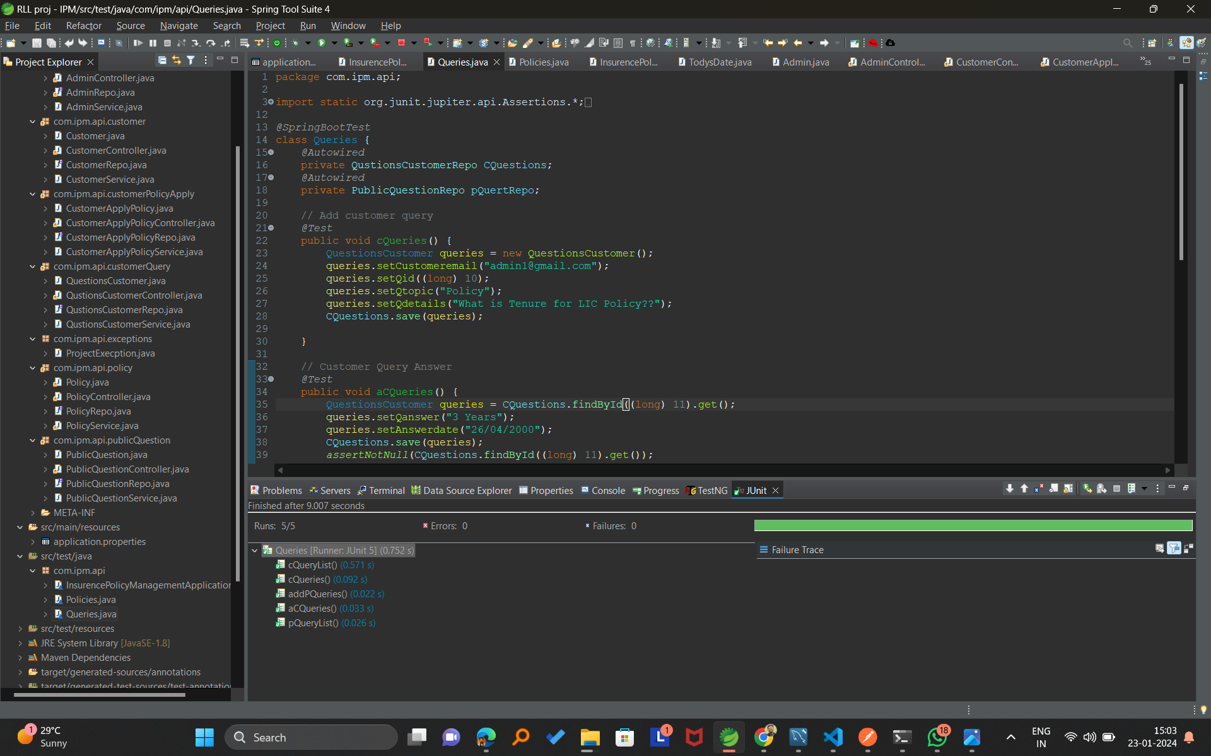
Junit Testing

Slide 36
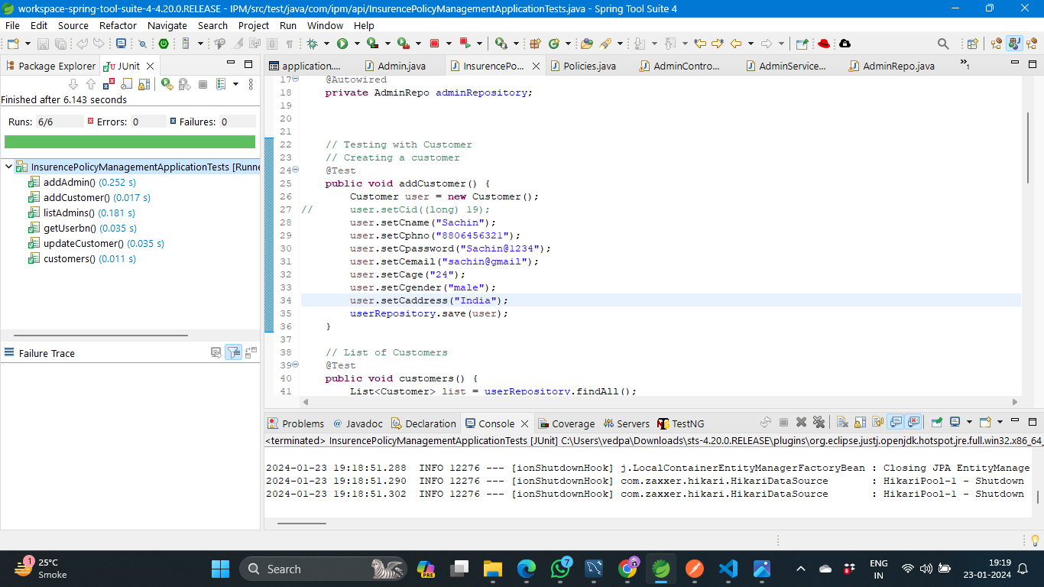
Junit Testing

Slide 37
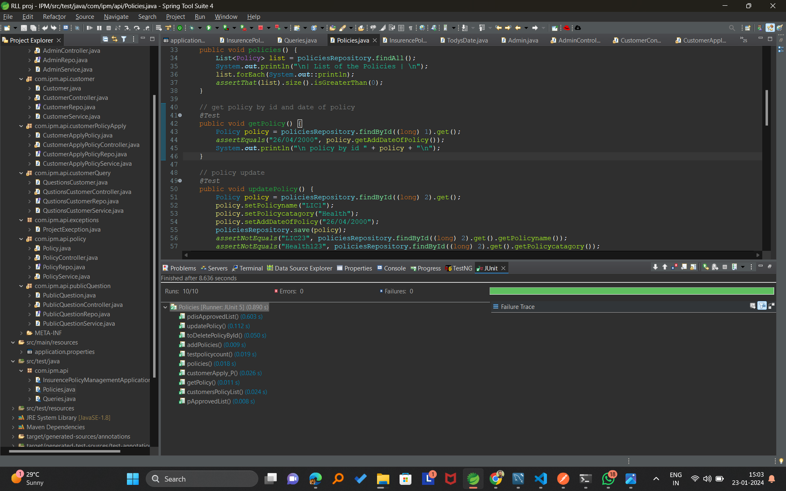
Junit Testing

Slide 38
CONCLUSION
In this insurance policy management performing the minimalistic and improved features for user frontend and backend.
It will help to improve admin service and customer service, reduce process costs, streamline the search of applying policies, applied policies approval or not, etc.

Slide 39
FUTURE ENHANCEMENT
Add payment methods for our application.
The administrator can add and remove policy into the database on a weekly basis.
Promotional Emails.

Slide 40


